Slide 1
Service-Learning Program at Petra Christian University
LOVE is the spirit of FAITH
SERVICE is the spirit of LOVE
Serving to Learn
Learning to Serve

Slide 2
Why should be Service-Learning?
Vision:
To be a caring and global university that is committed to Christian values
LIGHT value:
Love – is the spirit of caring
Integrity – is character in action
Growth – is the fruit of holistic learning
Humility – is the beginning of wisdom
Truth – is the basis of true life
Profile of Alumni:
Academic excellence, Emotional excellence, and Spiritual excellence

Slide 3
Why should be Service-Learning?
Holistic Education
Academic Excellence
Emotional Excellence
Spiritual Excellence
SL is a holistic education which integrates all student aspects: academic, emotional, spiritual

Slide 4
Service and Learning Typology
Sygmon, 1994
Service-LEARNING Learning goals primary Service outcomes secondary
SERVICE-learning Service outcomes primary
Learning goals secondary
Service Learning Service and learning goals completely separate
SERVICE-LEARNING Service and learning goals of equal weight. Each enhances other for all participants

Slide 5
Experiential Learning Continuum
Recipient
Who is BENEFITTING?
Provider
Service
What is the main FOCUS?
Learning
SERVICE-LEARNING
COMM. SERVICE
FIELD EDUCATION
VOLUNTEERISM
INTERNSHIP
Adapted from
Furco, 1996

Slide 6
Volunteerism
Volunteerism refers to people who of their own free will and without pay, perform some service or good work (such as with charitable institutions or community agencies). Many of you may have volunteered while growing up through scouting, church youth groups or other organizations.

Slide 7
Community Service
Community service is a form of volunteerism.
The important point here is that the community service is done within in a defined community.
Some examples could include: your classroom, your school, the town where your students live their city, etc. There does not have to be an intentional attach to learning; the emphasis is placed strictly on the service that is performed.

Slide 8
Internships
Student the primary beneficiary
Focus on student learning
  Goal is to acquire skills and knowledge

Slide 9
Field Education
Service activities related to but not fully integrated into academics
Focus on maximizing student learning

Slide 10
What is Service-Learning?
A “teaching methodology that combines community service with
  explicit academic learning objectives,
  preparation and
  reflection
Students provide community service but learn about the context in which it is provided, the connection between the service and their academic coursework, and their roles as citizens” (Seifer, CCPH, 2000).

Slide 11
Service-Learning
Equal benefit to provider and recipient of service
Equal focus on service and learning
Every individual, organization, and entity involved functions as both teacher and learner
Must have academic context that ensures
  Service enhances learning
  Learning enhances service

Slide 12
Graduation Requirement
Service-Learning is a must for each student
Since 2011, each student should take minimum one Service-Learning course

Slide 13
Types of Service-Learning (SL)
Mono-discipline SL
  Organized at department level
Multi-discipline or inter-discipline SL
  Organized at faculty or university level

Slide 14
Requirement for Service-learning
Link to Curriculum
Meaningful SL through service practicum
Reflection
Diversity
Partnership
Progress Monitoring/Mentoring
Duration and Intensity

Slide 15
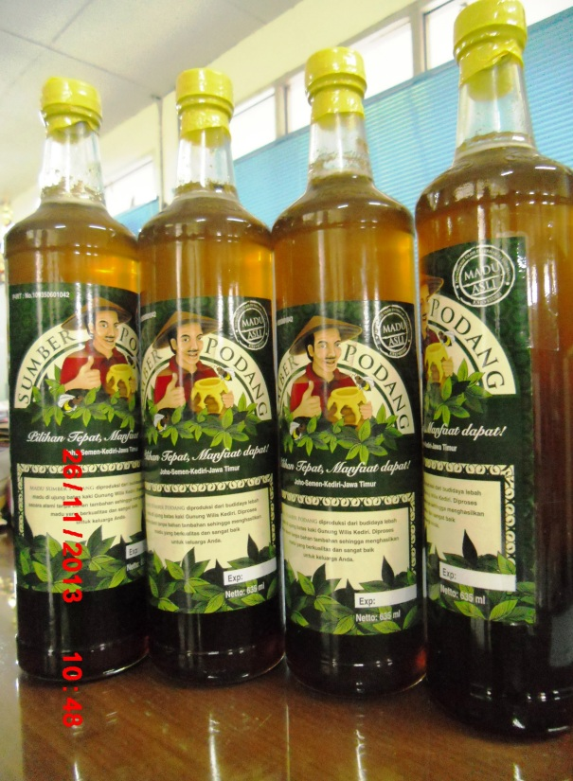

Packaging Design Course
National Award: 1st winner Pack 2i Academy Design Award for Herbal Category, 2009
Asia Award: Award for Packaging Excellence Asia Star 2009 (Students Category)

Slide 16
Elements of Service-Learning
Elements of SL
Preparation
Action
Reflection
Celebration

Slide 17
Preparation
Knowledge for the project
(Lecturing in class, mentoring)
Preparation includes everything that is done to help the participants develop the necessary skills

Slide 18
Action
The meaningful service performed by participants can take many forms and may include teaching others, creating a product or performance, providing a service or advocating for change.
The action can occur in one day, over a particular week, as well as over the course of several months.

Slide 19
Reflection
Processing or reconstructing the service experience helps to make the connection to learning.
Could take many different forms. For example: writing, doing, telling, and reading etc.

Slide 20
Why reflect?
Reflection is crucial for integrating the service experience with classroom topics.
We do not learn from experience unless we take time to reflect on it.
Without reflection, our service is merely volunteerism--not service-learning.
It helps us to take notice of what we are learning from our service experiences--similar to the way that one highlights the important parts of a book with a color marker.
It is these “highlights” that help students bridge classroom theory with the real world.

Slide 21
Students’ Reflections
☹ I am used to live with AC, so when I went to the gempol kurung village, it was so hard for me because the weather is so hot. I thought that this class is too hard physically and also I have to spend a lot of money. And when I went to the field for monitoring by our own group , we got lost and my car got stuck in a dry ditch …. Even though we finally came to the place, we felt it was bad experience.
☺ The thing that touched me was when the owner of the house smiled and said thank you for helping them in getting a better house. I was encouraged when I saw the Surabaya International High School students show great enthusiasm during the BOSS program.

Slide 22
Students’ Reflections
☺ I never knew that there are poor communities in reality. I ever saw it only on television. So when I went to the gempol kurung village and kedung turi kampung, I felt so grateful that I can live prosperously .
☺ The thing that I could not forget was after joining the BOSS program, my body hurt all over and I could not walk properly on the next day. This hurt continued for 3 days.
☺ I felt touched by the poorness of this community, so I want to find donation to help these people get a comfortable life.

Slide 23
Panduan Refleksi
Awal Perkuliahan
Apakah yang anda harapkan dengan mengikuti mata kuliah ini?

Slide 24
Panduan Refleksi
Selama survey
Apakah kegiatan yang anda lakukan ? Deskripsikan dengan jelas !
Apakah kendala yang anda hadapi ? Bagaimana solusinya ?
Pelajaran berharga apa yang anda dapatkan ?

Slide 25
Panduan Refleksi
Setelah implementasi proyek
Bagaimana pendapat anda mengenai komunitas yang anda layani? (perspektif ekonomi, sosial, dan budaya)
Bagaimana pencapaian tujuan anda? Faktor-faktor apakah yang membuat berhasil/tidaknya proyek anda?
Pelajaran berharga apakah yang anda dapatkan dari komunitas yang dilayani?

Slide 26
Panduan Refleksi
Setelah implementasi proyek
Nilai-nilai karakter dan softskill paling menonjol apakah yang anda dapatkan ?
Bagaimana kegiatan ini dapat menolong anda untuk lebih mengenal diri anda sendiri?
Bagaimana metode SL ini dapat menolong anda memahami mata kuliah?
Apakah yang anda harapkan seperti di awal perkuliahan tercapai?

Slide 27
Celebration/Demonstration
It’s important to acknowledge that participant and communities have completed their project and done a GREAT job.
Everyone that participated in doing the service should be included in the celebration/demonstration.
This should include public officials, site personnel and the media. Students now have the opportunity to show what they have accomplished.

Slide 28
Other Important Elements

Slide 29
Participant Voice
Participants should play an active role in the selection, design, implementation, as well as evaluation of the service learning project.

Slide 30
Genuine Need
It is important that the service learning project meet a genuine/true community need.

Slide 31
Connection to Learning
Effective service learning establishes clear learning outcomes that require application of concepts, content and skills, as well as involve participants in the construction of their own knowledge.

Slide 32
Partnerships
Promoting communication & interaction with the community encourages partnerships and collaboration. Partnerships can include: businesses, community organizations, historical societies, colleges/universities, public or private school, social service agencies and National Service Programs.

Slide 33
Connecting Service-Learning
Start With The Learning
Start With The Service
Connect to the Service
Connect with the Learning

Slide 34
Start With The Learning
If you are attempting to find opportunities to integrate a service component into your regular academic program here are three questions by which you can explore possible connections around any unit of instruction.
Teach others—Could students teach what they have learned (skill, knowledge) to others?
Product Performance—Could the results of the students efforts be contributed to a product or presented to someone?
Addressing Community Need/Issue—Could the classroom learning be applied to provide a service or to help solve a real concern in the school or community?

Slide 35
Start With The Service
If you are attempting to find service opportunities that you can then integrate into your academic program, here are a few ways to find community needs or problems to address through service.
Needs/Assets List – With students create a list of all of the good and bad
things about the community.

Slide 36
The Curriculum Connection
Social Studies Unit on Vandalism
Health Unit on Safety
Science Unit on Local Flora & Fauna
Science/Social Studies Unit on Aging
Science Unit on Conservation
Painting Mural on Public Building Downtown
Lobby for a Traffic Light Near School
Creating a Nature Trail
Making and Playing Games With Residents at a Nursing Home
Developing a School-Wide Recycling Program

Slide 37
The Curriculum Connection
Social Studies Unit on Hunger and Poverty
Language Arts Unit on Letter Writing
Social Studies Unit on Laws Protecting Those With Disabilities
Organizing Canned Food Drive for the Homeless Shelter
Writing Letters to Nursing Home Residents
Building A Ramp for Wheelchairs at a Local Community Agency

Slide 38
Service Learning examples
Education students teach literacy, read to children, and plan developmentally appropriate recreation activities for school children.
Nursing students perform immunization for children in health clinics, analyze the prevalence of immunization, and work with the health department.

Slide 39
Service Learning examples
English students generate and document folklore of the community for hometown publication.
Math students provide statistical analysis of seasonal fluctuations in the local economy and employment. Tutoring math-phobic children in mathematical skills is another possibility.

Slide 40
Service Learning examples
Religion students observe and analyze different prayer traditions, then build an ecumenical prayer house.
Food Science students conduct workshops at elderly resident homes about changing nutritional needs as a function of aging.

Slide 41
Service Learning examples
Research Methodology students design survey questionnaires to help community service agencies obtain data that will help them provide better service.
Photography students create a promotional video to help area residents plant and harvest food for distribution to low-income families.

Slide 42
Service Learning examples
Clinical Psychology students volunteer at local hotlines to help victims of sexual assault and domestic violence.
Business students survey food and drug stores in community to establish relative prices and quality of essential items and issue monthly listing of this information to prevent stores in low-income communities from raising prices above those in surrounding stores.

Slide 43
Service Learning examples
11-12
Political Science students teach villagers about their voting rights, also form non-partisan watchdog group to provide background and voting records of candidates.
Environmental Science students collect trash out of an urban streambed, analyze the trash and the water to identify possible sources of pollution, then share the results with residents of the neighborhood along with suggestions for reducing pollution.

Slide 44
Service Learning examples
13-14
Computer Programming students design personalized software for local non-profit organizations to better match volunteers and needs, and to better manage personnel, resources, and inventories.
History students develop and publish a local cultural journal that reports on the unique aspects of the community. A group in India works with communities to write their own history, then to write their own “Road to Development.”

Slide 45
SISTEM EVALUASI
Monitoring
Survey dan kunjungan awal.
Mahasiswa menyerahkan desain dan perencanaan dalam bentuk proposal tentang apa yang akan mereka lakukan di tempat S-L.
Proses pengerjaan yang bersamaan dengan kunjungan ke lokasi S-L yang dilakukan sesuai kebutuhan.
Frekuensi kunjungan mahasiswa ke lapangan
Refleksi
Laporan Projek

Slide 46
Penghargaan utk Mahasiswa
Selain mendapatkan nilai mata kuliah, mahasiswa yang mengikuti mata kuliah berbasis Service Learning akan mendapatkan tambahan SKKK Pengabdian Masyarakat
  Mata Kuliah COP : 3 SKKK
  Mata Kuliah lain : 1,5 SKKK
Mahasiswa memperoleh sertifikat setelah lulus mengikuti SL. Sertifikat tanda peserta (tanpa nilai) dikeluarkan oleh unit yang mengadakan

Slide 47
Penghargaan utk Dosen
Dosen pengajar Mata Kuliah SL memperoleh beban mengajar tambahan 1 (satu) SKS, dimana dihitung untuk per mata kuliah.

Slide 48
Why Service-Learning
What the Research Says

Slide 49
Potential Outcomes of Involvement in Service Learning
Academic
Problem Solving
Ethical Development
Social Responsibility
Assertiveness
Career Goals
Political Efficacy
Critical Thinking
Moral Reasoning
Self Esteem
Civic Responsibility
Tolerance For Diversity

Slide 50
Benefits to Community
Enhances positive relationships with the college
Provides awareness-building of community issues, agencies, and constituents
Contributes to positive exposure in the community
May help to secure outside funding

Slide 51
Benefits to Students
Students develop a habit of critical reflections in their experiences, enabling them to learn throughout life
Students become more curious and motivated to learn.
Students increase their sense of social and civic responsibility
Students feel more committed to addressing the underlying problems behind social issues
Students understand problems in a more complex way and can imagine alternative solutions

Slide 52
Benefits to Students
Students demonstrate more sensitivity to how decisions are made and how institutional decisions affect people’s lives
Students learn to respect cultural differences
Students learn to work more collaboratively with other people on real problems
Students realize that they can make a difference.

Slide 53
Benefits to Institution
Facilitates teaching, research, and program development
Increases institution’s awareness of societal issues as they relate to academic areas of interest
Engages faculty and students in local and state community issues
Provides opportunities to extend College’s knowledge and resources

Slide 54
What Americans Want from
Public Education
In a survey of 1000 Americans, research found:
  94% agreed a good education is much more than just learning to read, write and do math, and
  89% agreed that schools need to teach in different ways to reach different types of students.
  When given a definition of service learning, 90% agreed they were likely to support it in their local public schools,
  90% said they were likely to support service learning if academic skills were tied to service, and
  90% agreed that service learning helps students build the skills they need to be successful later in life.
  (Roper Starch Worldwide for the W. K. Kellogg Foundation, 2000)

Slide 55
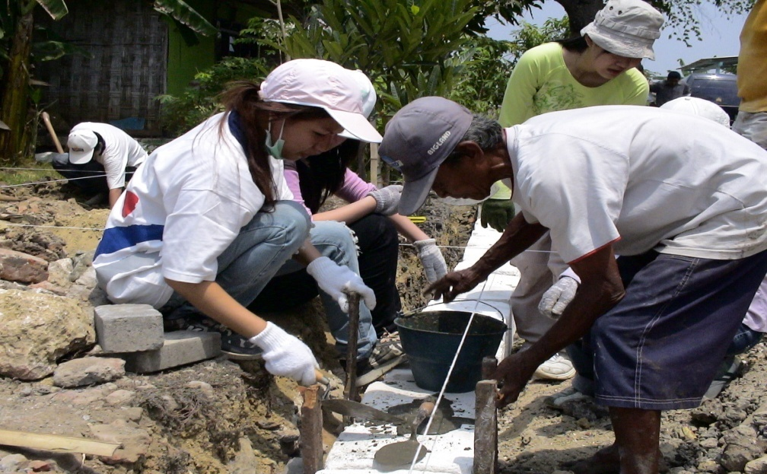
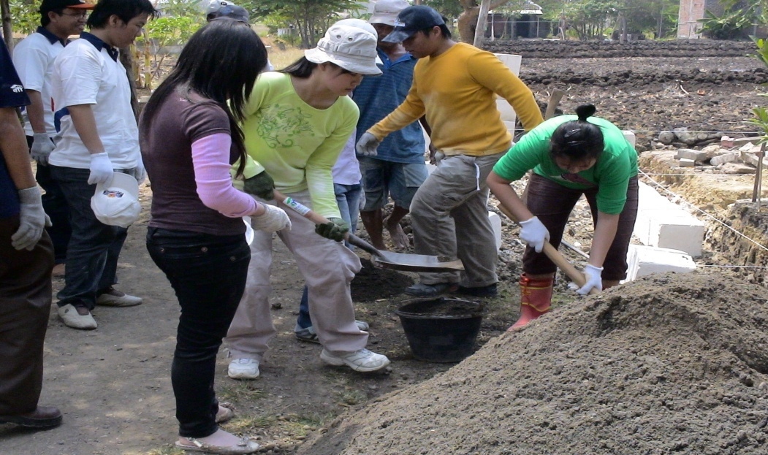
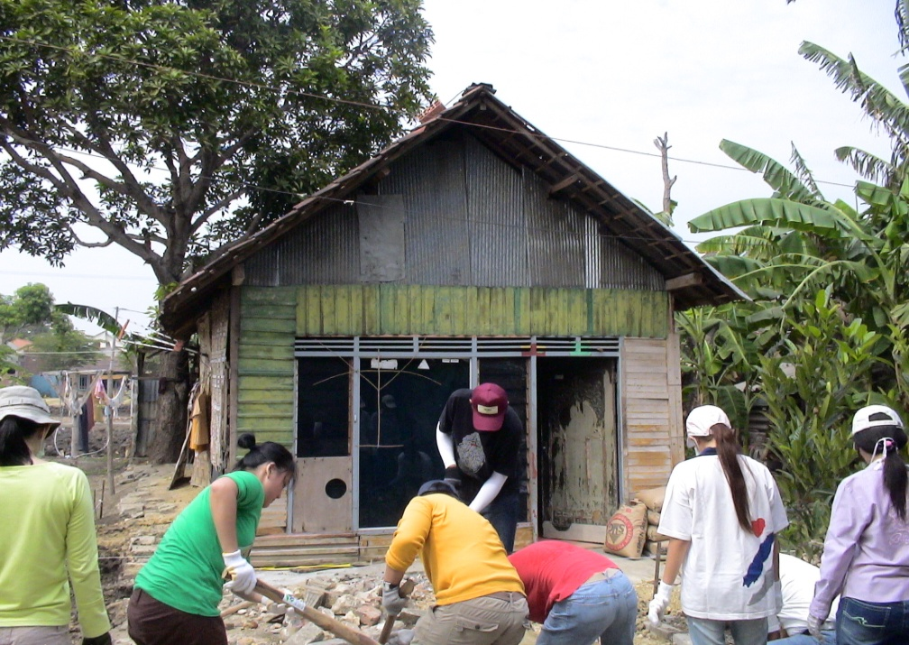
Dokumentasi Kegiatan SL
Kegiatan Membangun Rumah Sehat
Kerjasama dengan Habitat

Slide 56
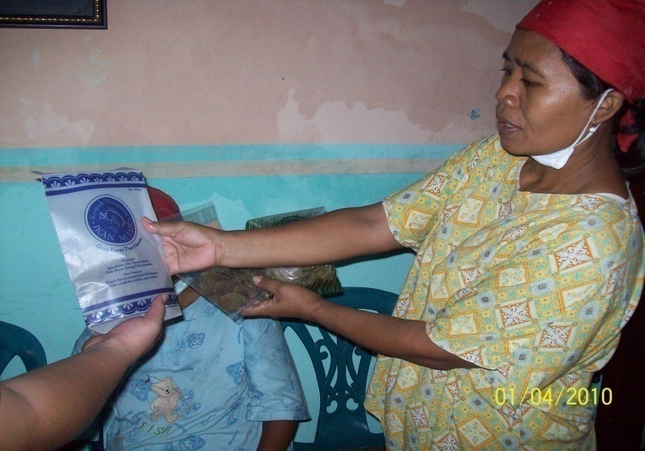
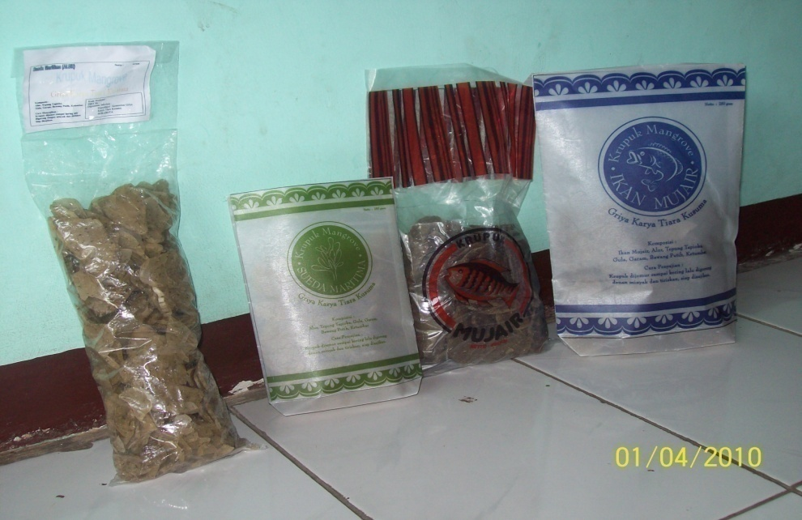
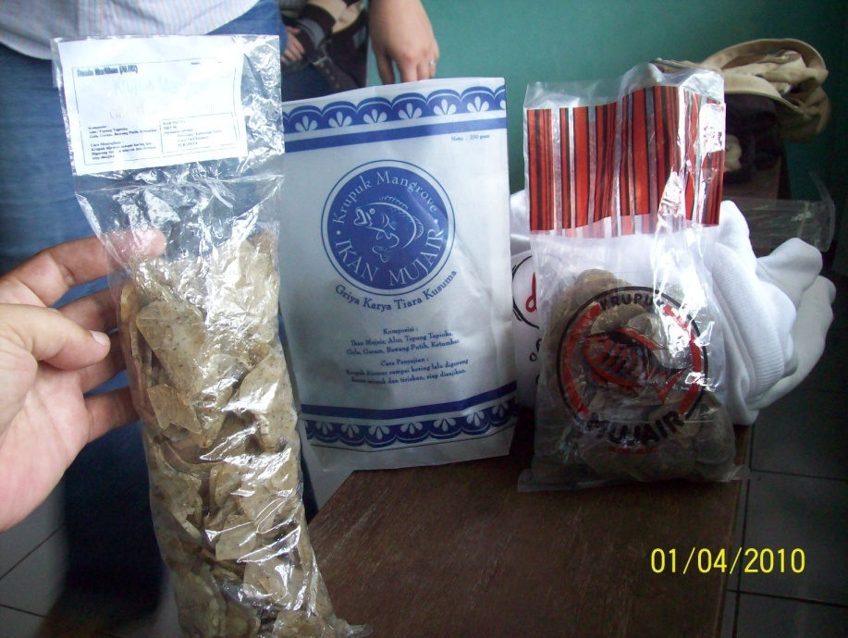
Dokumentasi Kegiatan SL
Kegiatan Desain Kemasan UMKM di Kec Rungkut

Slide 57
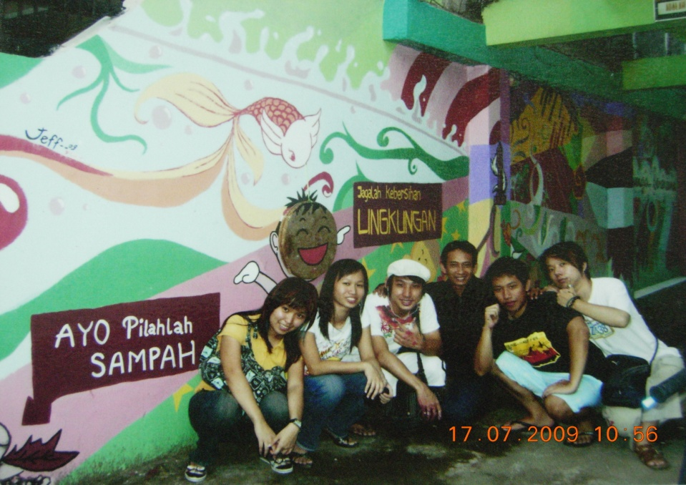
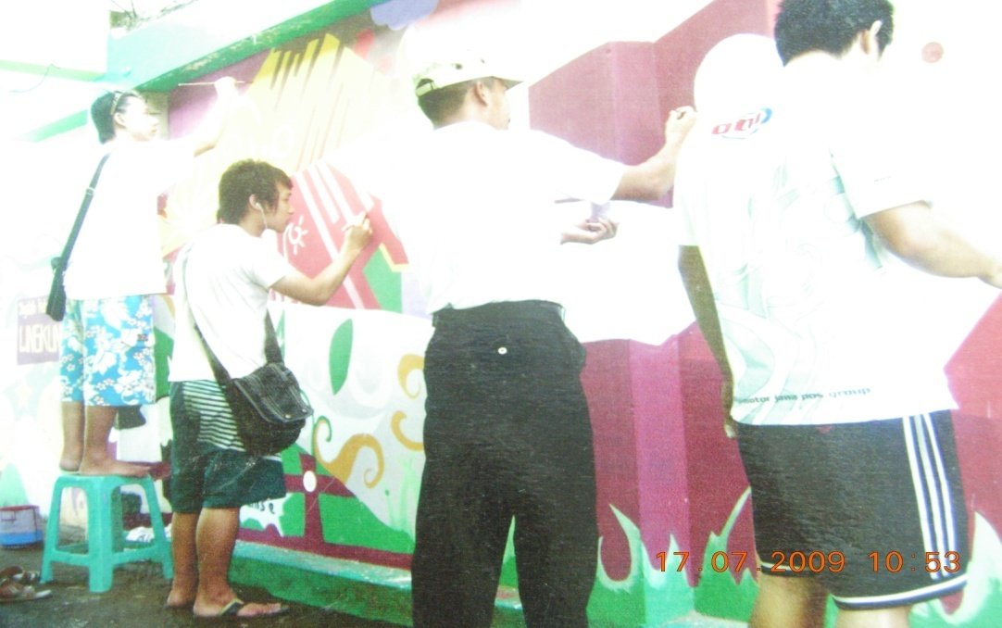
Dokumentasi Kegiatan SL
Kegiatan Macaki Kampung di Siwalankerto

