Slide 1
Introduction to
Service-Learning
LOVE is the spirit of FAITH
SERVICE is the spirit of LOVE
Serving to Learn
Learning to Serve

Slide 2
Why should be Service-Learning?
Vision:
To be a caring and global university that is committed to Christian values
LIGHT value:
Love – is the spirit of caring
Integrity – is character in action
Growth – is the fruit of holistic learning
Humility – is the beginning of wisdom
Truth – is the basis of true life
Profile of Alumni:
Academic excellence, Emotional excellence, and Spiritual excellence

Slide 3
Why should be Service-Learning?
Holistic Education
Academic Excellence
Emotional Excellence
Spiritual Excellence
SL is a holistic education which integrates all student aspects: academic, emotional, spiritual

Slide 4
Service and Learning Typology
Sygmon, 1994
Service-LEARNING Learning goals primary Service outcomes secondary
SERVICE-learning Service outcomes primary
Learning goals secondary
Service Learning Service and learning goals completely separate
SERVICE-LEARNING Service and learning goals of equal weight. Each enhances other for all participants

Slide 5
Experiential Learning Continuum
Recipient
Who is BENEFITTING?
Provider
Service
What is the main FOCUS?
Learning
SERVICE-LEARNING
COMM. SERVICE
FIELD EDUCATION
VOLUNTEERISM
INTERNSHIP
Adapted from
Furco, 1996

Slide 6
Volunteerism
Volunteerism refers to people who of their own free will and without pay, perform some service or good work (such as with charitable institutions or community agencies). Many of you may have volunteered while growing up through scouting, 4-H, church youth groups or other organizations.

Slide 7
Community Service
Community service is a form of volunteerism.
The important point here is that the community service is done within in a defined community.
Some examples could include: your classroom, your school, the town where your students live their city, etc. There does not have to be an intentional attach to learning; the emphasis is placed strictly on the service that is performed.

Slide 8
Internships
Student the primary beneficiary
Focus on student learning
  Goal is to acquire skills and knowledge

Slide 9
Field Education
Service activities related to but not fully integrated into academics
Focus on maximizing student learning

Slide 10
What is Service-Learning?
A “teaching methodology that combines community service with
  explicit academic learning objectives,
  preparation and
  reflection
Students provide community service but learn about the context in which it is provided, the connection between the service and their academic coursework, and their roles as citizens” (Seifer, CCPH, 2000).

Slide 11
Service-Learning
Equal benefit to provider and recipient of service
Equal focus on service and learning
Every individual, organization, and entity involved functions as both teacher and learner
Must have academic context that ensures
  Service enhances learning
  Learning enhances service

Slide 12
Graduation Requirement
Service-Learning is a must for each student
Since 2011, each student should take minimum one Service-Learning course

Slide 13
Types of Service-Learning (SL)
Mono-discipline SL
  Organized at department level
Multi-discipline or inter-discipline SL
  Organized at faculty or university level

Slide 14
Requirement for Service-learning
Link to Curriculum
Meaningful SL through service practicum
Reflection
Diversity
Partnership
Progress Monitoring/Mentoring
Duration and Intensity

Slide 15
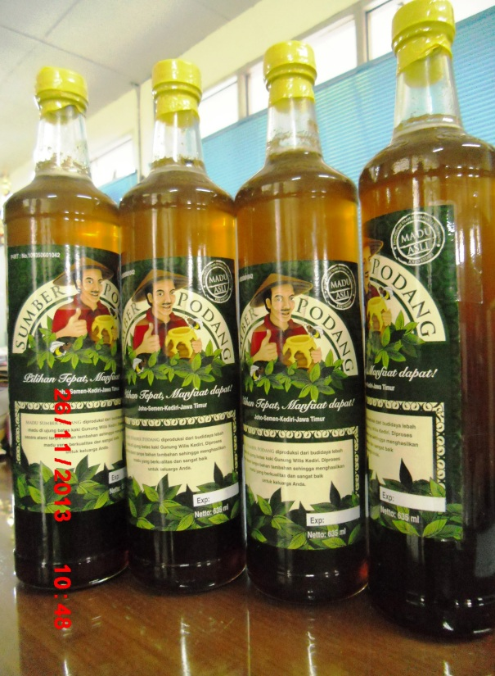

Packaging Design Course
National Award: 1st winner Pack 2i Academy Design Award for Herbal Category, 2009
Asia Award: Award for Packaging Excellence Asia Star 2009 (Students Category)

Slide 16
Elements of Service-Learning
Elements of SL
Preparation
Action
Reflection
Celebration

Slide 17
Preparation
Knowledge for the project
(Lecturing in class, mentoring)
Preparation includes everything that is done to help the participants develop the necessary skills

Slide 18
Action
The meaningful service performed by participants can take many forms and may include teaching others, creating a product or performance, providing a service or advocating for change.
The action can occur in one day, over a particular week, as well as over the course of several months.

Slide 19
Reflection
Processing or reconstructing the service experience helps to make the connection to learning.
Could take many different forms. For example: writing, doing, telling, and reading etc.

Slide 20
Why reflect?
Reflection is crucial for integrating the service experience with classroom topics.
We do not learn from experience unless we take time to reflect on it.
Without reflection, our service is merely volunteerism--not service-learning.
It helps us to take notice of what we are learning from our service experiences--similar to the way that one highlights the important parts of a book with a color marker.
It is these “highlights” that help students bridge classroom theory with the real world.

Slide 21
Students’ Reflections
☹ I am used to live with AC, so when I went to the gempol kurung village, it was so hard for me because the weather is so hot. I thought that this class is too hard physically and also I have to spend a lot of money. And when I went to the field for monitoring by our own group , we got lost and my car got stuck in a dry ditch …. Even though we finally came to the place, we felt it was bad experience.
☺ The thing that touched me was when the owner of the house smiled and said thank you for helping them in getting a better house. I was encouraged when I saw the Surabaya International High School students show great enthusiasm during the BOSS program.

Slide 22
Students’ Reflections
☺ I never knew that there are poor communities in reality. I ever saw it only on television. So when I went to the gempol kurung village and kedung turi kampung, I felt so grateful that I can live prosperously .
☺ The thing that I could not forget was after joining the BOSS program, my body hurt all over and I could not walk properly on the next day. This hurt continued for 3 days.
☺ I felt touched by the poorness of this community, so I want to find donation to help these people get a comfortable life.

Slide 23
Panduan Refleksi
Awal Perkuliahan
Apakah yang anda harapkan dengan mengikuti mata kuliah ini?

Slide 24
Panduan Refleksi
Selama survey
Apakah kegiatan yang anda lakukan ? Deskripsikan dengan jelas !
Apakah kendala yang anda hadapi ? Bagaimana solusinya ?
Pelajaran berharga apa yang anda dapatkan ?

Slide 25
Panduan Refleksi
Setelah implementasi proyek
Bagaimana pendapat anda mengenai komunitas yang anda layani? (perspektif ekonomi, sosial, dan budaya)
Bagaimana pencapaian tujuan anda? Faktor-faktor apakah yang membuat berhasil/tidaknya proyek anda?
Pelajaran berharga apakah yang anda dapatkan dari komunitas yang dilayani?

Slide 26
Panduan Refleksi
Setelah implementasi proyek
Nilai-nilai karakter dan softskill paling menonjol apakah yang anda dapatkan ?
Bagaimana kegiatan ini dapat menolong anda untuk lebih mengenal diri anda sendiri?
Bagaimana metode SL ini dapat menolong anda memahami mata kuliah?
Apakah yang anda harapkan seperti di awal perkuliahan tercapai?

Slide 27
Panduan Refleksi
Setelah implementasi proyek
Bagaimana pendapat anda mengenai komunitas yang anda layani? (perspektif ekonomi, sosial, dan budaya)
Bagaimana pencapaian tujuan anda? Faktor-faktor apakah yang membuat berhasil/tidaknya proyek anda?
Pelajaran berharga apakah yang anda dapatkan dari komunitas yang dilayani?

Slide 28
Panduan Refleksi
Nilai-nilai karakter dan softskill paling menonjol apakah yang anda dapatkan ?
Bagaimana kegiatan ini dapat menolong anda untuk lebih mengenal diri anda sendiri?
Bagaimana metode SL ini dapat menolong anda memahami mata kuliah?

Slide 29
Celebration/Demonstration
It’s important to acknowledge that participant and communities have completed their project and done a GREAT job.
Everyone that participated in doing the service should be included in the celebration/demonstration.
This should include public officials, site personnel and the media. Students now have the opportunity to show what they have accomplished.

Slide 30
Other Important Elements

Slide 31
Participant Voice
Participants should play an active role in the selection, design, implementation, as well as evaluation of the service learning project.

Slide 32
Genuine Need
It is important that the service learning project meet a genuine/true community need.

Slide 33
Connection to Learning
Effective service learning establishes clear learning outcomes that require application of concepts, content and skills, as well as involve participants in the construction of their own knowledge.

Slide 34
Partnerships
Promoting communication & interaction with the community encourages partnerships and collaboration. Partnerships can include: businesses, community organizations, historical societies, colleges/universities, public or private school, social service agencies and National Service Programs.

Slide 35
Penghargaan utk Mahasiswa
Selain mendapatkan nilai mata kuliah, mahasiswa yang mengikuti mata kuliah berbasis Service Learning akan mendapatkan tambahan SKKK Pengabdian Masyarakat
  Mata Kuliah COP : 3 SKKK
  Mata Kuliah lain : 1,5 SKKK
Mahasiswa memperoleh sertifikat setelah lulus mengikuti SL. Sertifikat tanda peserta (tanpa nilai) dikeluarkan oleh program studi/program

Slide 36
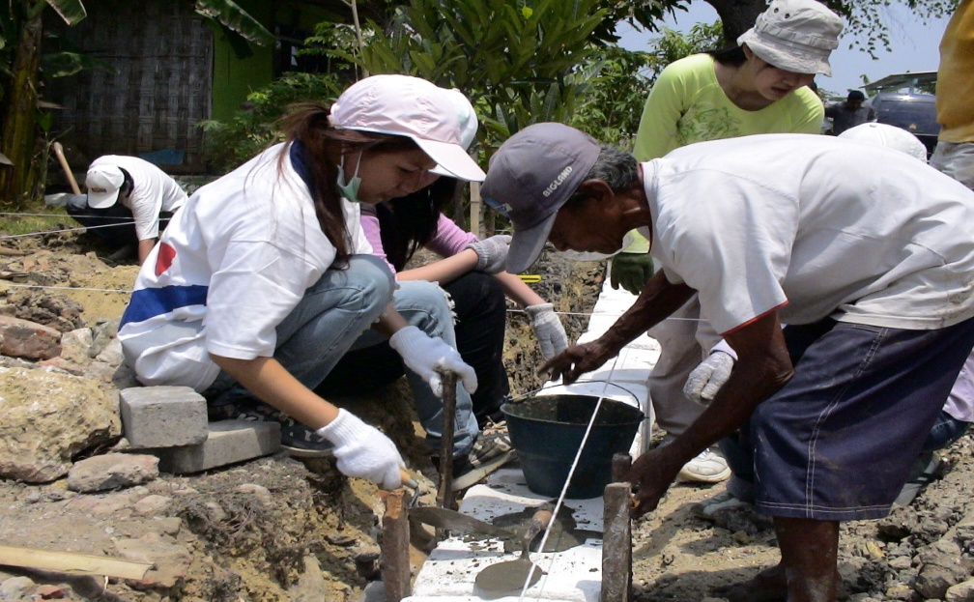
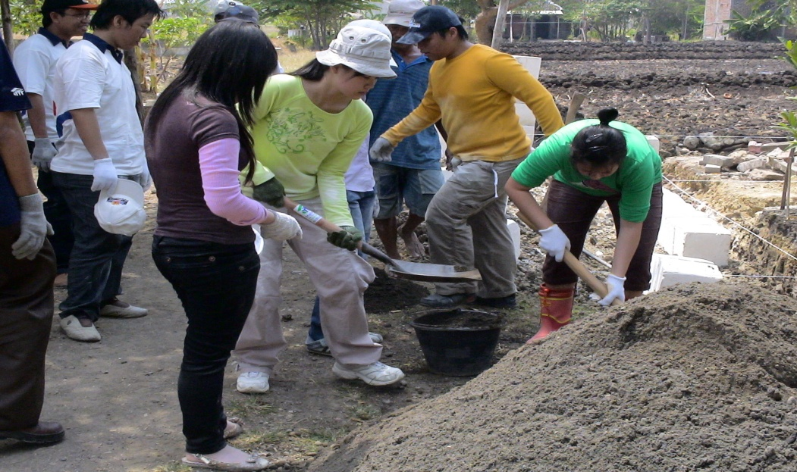
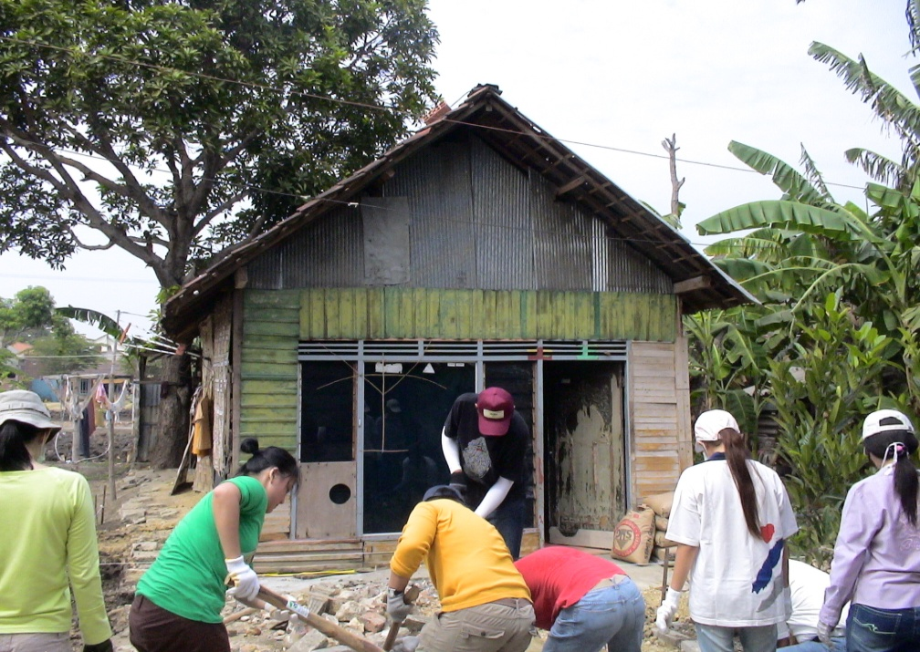
Dokumentasi Kegiatan SL
Kegiatan Membangun Rumah Sehat
Kerjasama dengan Habitat

Slide 37
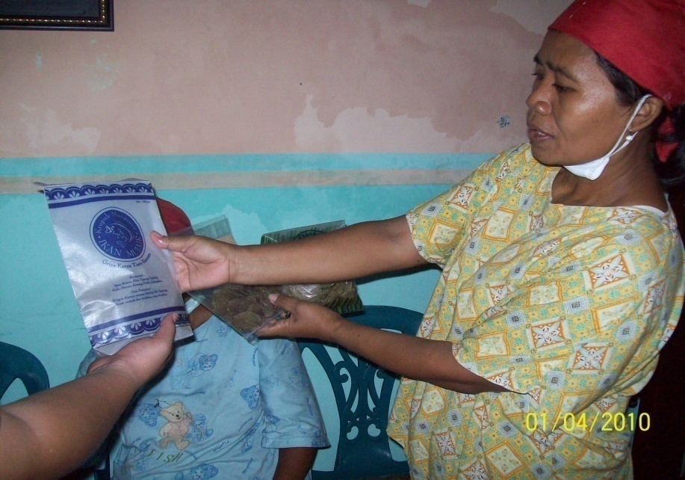
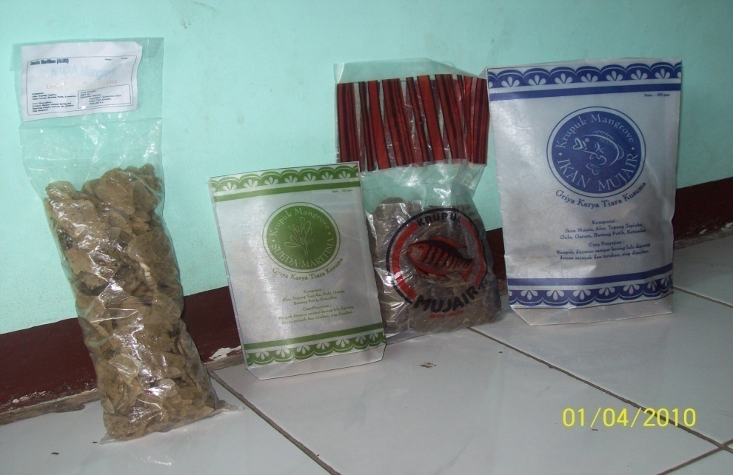
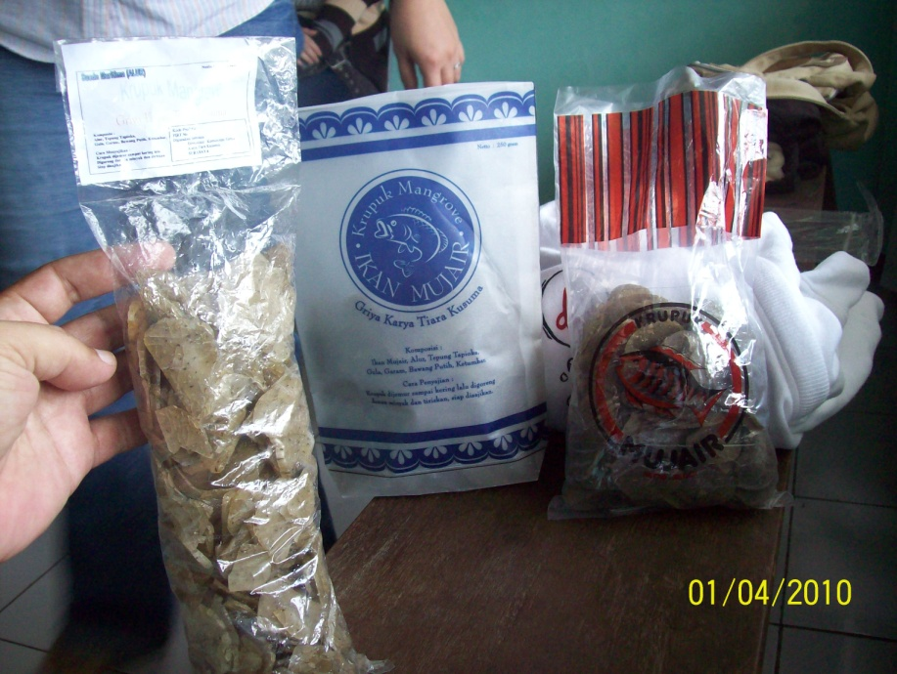
Dokumentasi Kegiatan SL
Kegiatan Desain Kemasan UMKM di Kec Rungkut

Slide 38
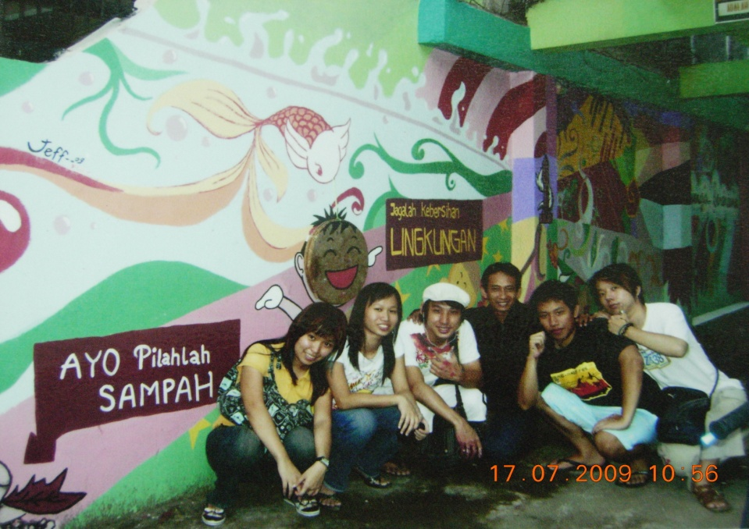
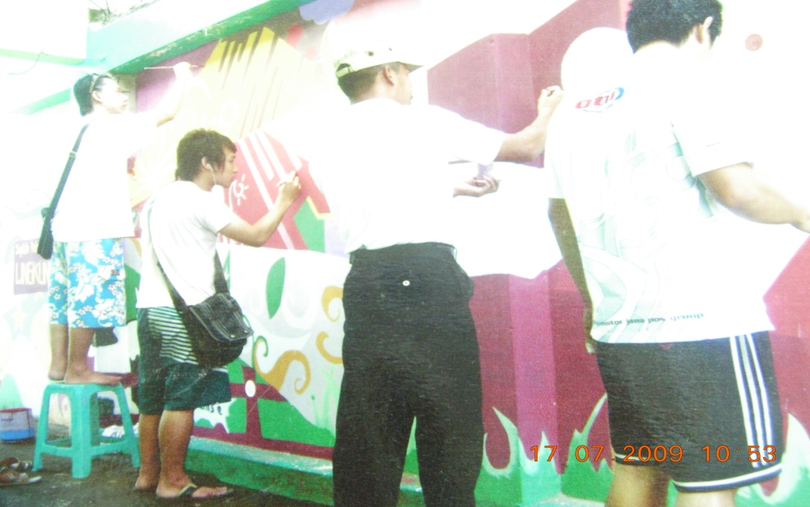
Dokumentasi Kegiatan SL
Kegiatan Macaki Kampung di Siwalankerto

